Slide 1


Introduction to ESG and Impact Investing
Ben Constable Maxwell, Head of Impact Investing
November 2020
Notes:
Notes Presentation Title Page
Date
Type name of Presenters

Slide 2

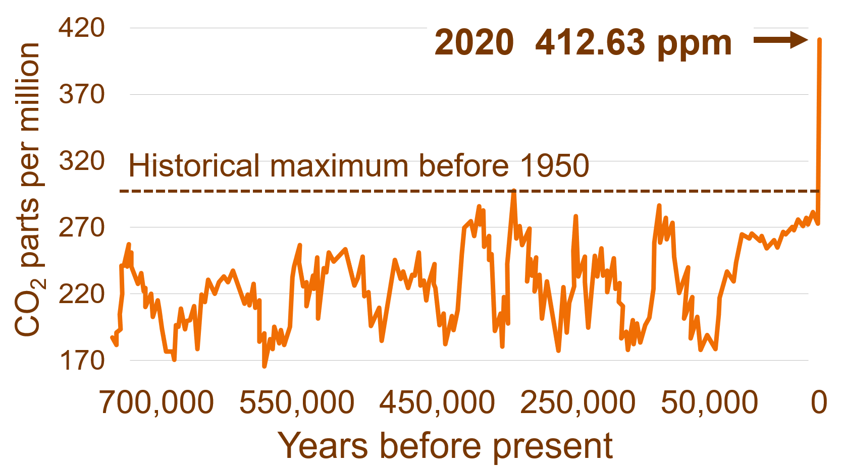











Challenges facing the world today
Population Growth
7.8 bn people today
expect 9.8 bn by 2050
Climate Change linked to fossil fuels and tropical deforestation
Deforestation
4 commodities: soy, palm oil, beef, timber
2ºc
Vs
1.5ºc
15,000 sq miles
tropical land destroyed
each year
Demand for food and energy
Pressure on scarce resources
Negative environmental impact
CO₂ rising 10 times faster than any sustained rise in 800,000 years
Pushes planetary boundaries
Accelerates biodiversity loss
Human intrusion biodiversity hotspots
Disruption and disturbance
Ecosystem degradation
Source: United Nations, 2020
Source: NASA, NOAA, IPCC, 2020*
Source: Union of Concerned Scientists, 2020
Consumption & Production
Increasing demand for animal protein
Health & Wellbeing
Ensure healthy lives
Combat communicable disease
50bn
More than 50bn
1.5bn
animals consumed

1.5bn
0.5bn
Unsustainable production & consumption
Reduce food waste increase plant-based
Tackle overuse and misuse of antibiotics
Emergence of infectious disease
Underprepared health systems
Dislodged viruses
Source: World Economic Forum, 2020
*NASA (National Aeronautics & Space Administration), NOAA (National Oceanic & Atmospheric Administration), IPCC (Intergovernmental Panel on Climate Change)

Slide 3

Climate Change
GHG concentrations happening 10 times faster than any sustained rise in CO₂ during past 800,000 years
2020 412.63 ppm
We need to stabilise GHG concentrations to prevent dangerous anthropogenic interference with the climate system
We must listen to the Earth’s best scientists;
climate change moving faster than we are
700,000
550,000
450,000
250,000
50,000
0
Staying below 1.5ºC requires rapid, far-reaching and unprecedented changes to all aspects of society
Source: NASA, NOAA, March 2020

Slide 4










What does ESG mean?
The limitations of traditional financial analysis
Environmental
Social
Governance
Book value
Air and water pollution
Waste management
Energy efficiency
CO₂ emissions
Customer privacy
Labour health and safety
Training and development
Product safety
Leadership
Executive pay
Shareholder rights
Audits and internal controls
ESG issues

Slide 5
The spectrum of capital
Negative Screening
Values Investing
Risk framework to protect value
Positive screening
Sustainable winners
Positive screening
Impact
leaders
Traditional
Ethical
ESG
Sustainability
Impact
Financial returns focus
Avoiding Harm
Benefiting All Stakeholders
Contributing to Solutions
Intention to
generate measurable
positive impact, access for
under-served populations
Source: M&G, adapted from the Impact Management Project and ImpACT Alliance

Slide 6








Impact investing
Why now?
Global warming
Pollution and waste
Health issues
Biodiversity loss
Gender inequality
Inequalities
Poverty
Source; M&G

Slide 7




Impact investing
Applying impact–defining criteria to listed equities
Intentionality
Additionality
Materiality
Measurability
“Growing awareness of impact investing will require mutual fund managers to think creatively about how to select and manage publicly traded companies for positive impact”
Global Impact Investing Network (GIIN)
Source: M&G

Slide 8





Why does ESG matter?
Regulation
Climate Change
Consumer Preferences
Financial returns

Slide 9
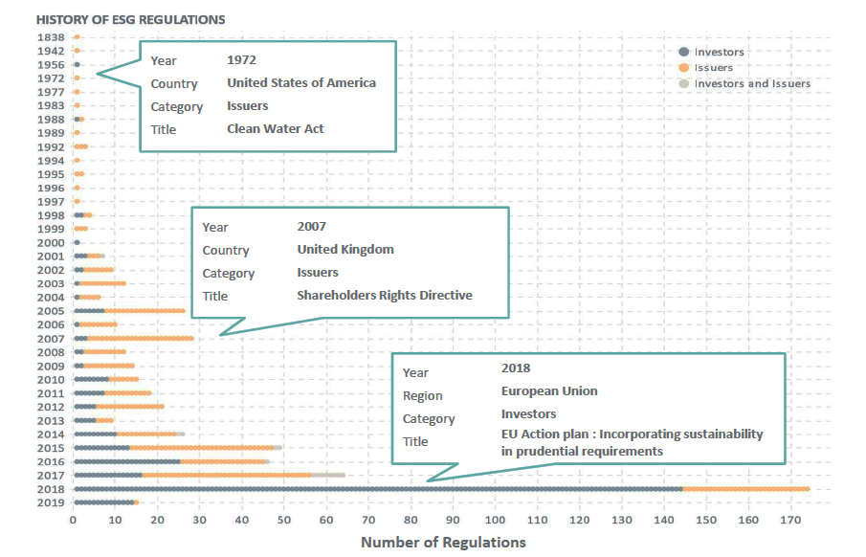
Exponential growth in ESG regulations
ESG regulation turning increasingly towards investors
Source: MSCI, ESG trends to watch in 2019, 22 January 2019
Notes:
NEW SLIDE MAR 19
BA PR + DP

Slide 10
Imminent introduction of the EU regulatory framework
Mainstreaming sustainability risks and directing capital towards sustainable opportunities
Action Plan on Sustainable
Finance (March 2018)
Re-orient capital flows towards sustainable investments
Mainstreaming sustainability risk into risk management
Foster transparency and long-termism in markets
Renewed sustainable finance strategy (consultation ongoing)
Strengthen the foundations of sustainable finance
Increasing opportunities for sustainable finance
Reducing and eliminating climate and environmental risks
EU
Sustainable
Finance
Framework
Taxonomy
Regulation
Sustainability
Disclosure
Regulation
Renewed sustainable finance strategy (end 2020)
Further initiatives
Green Bonds
Standard
UCITS and
AIFMD
Frameworks
MiFID and IDD
Framework
Non-Financial
Reporting
Green Bonds
Standard
EU
Ecolabel
CPR / Solvency
Prudential
Requirements
Corporate
Governance
Credit
Ratings
European Green deal – Cross-Sectoral Plan to transition Europe to Climate Neutrality by 2050
New EU Climate Law – to place tackling climate change at the core of EU policy-making
Source: https://www.irishfunds.ie/regulatory-technical/sustainable-finance

Slide 11
Why does ESG matter?
Regulation
Climate Change
Consumer Preferences
Financial returns

Slide 12
All 5 top risks are environmental
The WEF 2020 top risks
2015
2016
2017
2018
2019
2020
1
1
1
1
1
1 Extreme
weather
2 Involuntary
migration
2 Climate action failure
2 Climate action failure
2
2
2
3 Failure of national governance
3 Climate action failure
3
3
3
3 natural disasters
4 State collapse or crisis
4 Interstate conflict
4 Terrorist attacks
4
4 data fraud
or theft
4 Biodiversity loss
5 Unemployment
5 Natural catastrophes
5
5 Climate action failure
5 Cyberattacks
5 Human-made environmental disasters
Economic
Environmental
Geopolitical
Societal
Technological
Source: World Economic Forum

Slide 13
Why does ESG matter?
Regulation
Climate Change
Consumer Preferences
Financial returns

Slide 14
Climbing interest in Sustainable investing
95% of Millennials are interested
“How interested are you in sustainable investing - which is the practice of making investments in companies or funds which aim to achieve market-rate financial returns while pursuing positive social and/or environmental impact?”
Millennials
General population
95%
84%
86%
85%
71%
75%
Source: Morgan Stanley Institute for Sustainable Investing 3rd survey, September 2019

Slide 15
Why does ESG matter?
Regulation
Climate Change
Consumer Preferences
Financial returns

Slide 16


High Sustainability can lead to higher returns over the long term
In 2015, academics analysed more than 2,000 studies – and found that in roughly 90% of the studies, companies with strong ESG profiles had equal or better financial performance than their non-ESG counterparts
90%
Source: Deutsche Bank, ESG and financial performance: aggregated evidence from more than 2000 empirical studies, 2016

Slide 17

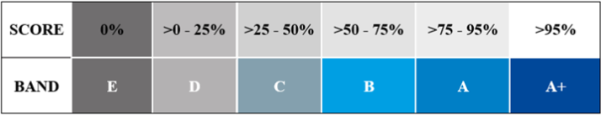
Signing to the PRI
Blueprint for Responsible Investing
6 Internationally recognised principles
Independent Assessment of commitment to incorporating ESG factors into investment decision making
Yearly Reporting Cycle
13 reporting modules, starting with:
- Organisational overview
- Strategy and Governance
Climate Change
Source: PRI https://www.unpri.org/pri.

Slide 18





Conclusion
ESG is the future, not a fad
ESG ≠ ethical
ESG is a process, not a type of fund
ESG supports better informed investment decision-making

Slide 19
ESG at M&G

Slide 20
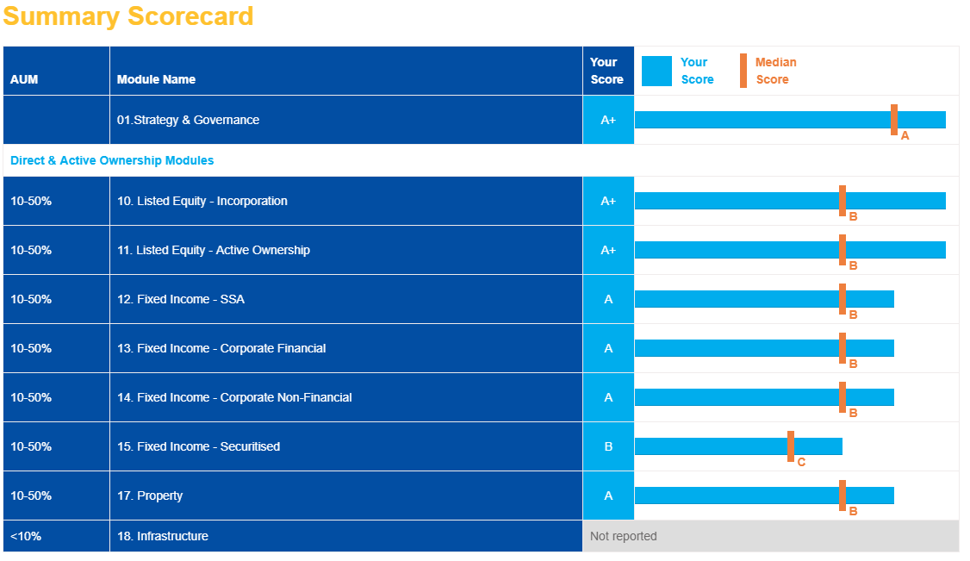
UNPRI Scorecard 2019
Continuing engagement with clients and issuers is key
M&G
Source: M&G, PRI Assessment Report: M&G Investments 2019.

Slide 21
ESG Integration
ESG Incorporation
Active ESG Engagement
Since 2016: Quarterly ESG portfolio reviews
Thematic: Single-Use Plastic
Key milestones
2018
Q1
Q2
Q3
Q4
Deep-Dive ESG Research
ESG Workshop Equity & Fixed Income
2019
Thematic: Cyber
Thematic: Palm Oil
ESG Engagement Framework
ESG Dashboards
ESG Integrated Equity & Fixed Income
Evidence: ESG #themes in Research
Q4
Q3
Q2
Q1
2018-2020
3-Year Journey
2020
Deliver: ESG Databank
Design: ESG Databank
Thematic: Deforestation
Source: SASB, TCFD, TPI
ESG Scorecard
Climate Scenario Analysis
Climate risk analysis
CA100+ Portfolio Decarbonisation
Q1
Q2
Q3
Q4
2021
Climate Change Approach
Investment Solutions
Thematic: Pandemics
Towards Paris Alignment

Slide 22












Our approach to ESG investment
Comprehensive ESG integration and a dedicated ESG range
ESG
ESG
ESG
ESG integrated into our mainstream funds across all asset classes
We offer an M&G ESG-labelled family of funds
ESG integration in practice
ESG
ESG
ESG
ESG
ESG
#
Historically long-term investors, active engagement & voting
Systematic integration of
E&S factors
ESG hashtags applied to analyst research
Proprietary tool records engagement outcomes
Data and insight collated in ESG dashboards
Regular ESG reviews of portfolios
Active, ESG-informed voting and engagement

Slide 23
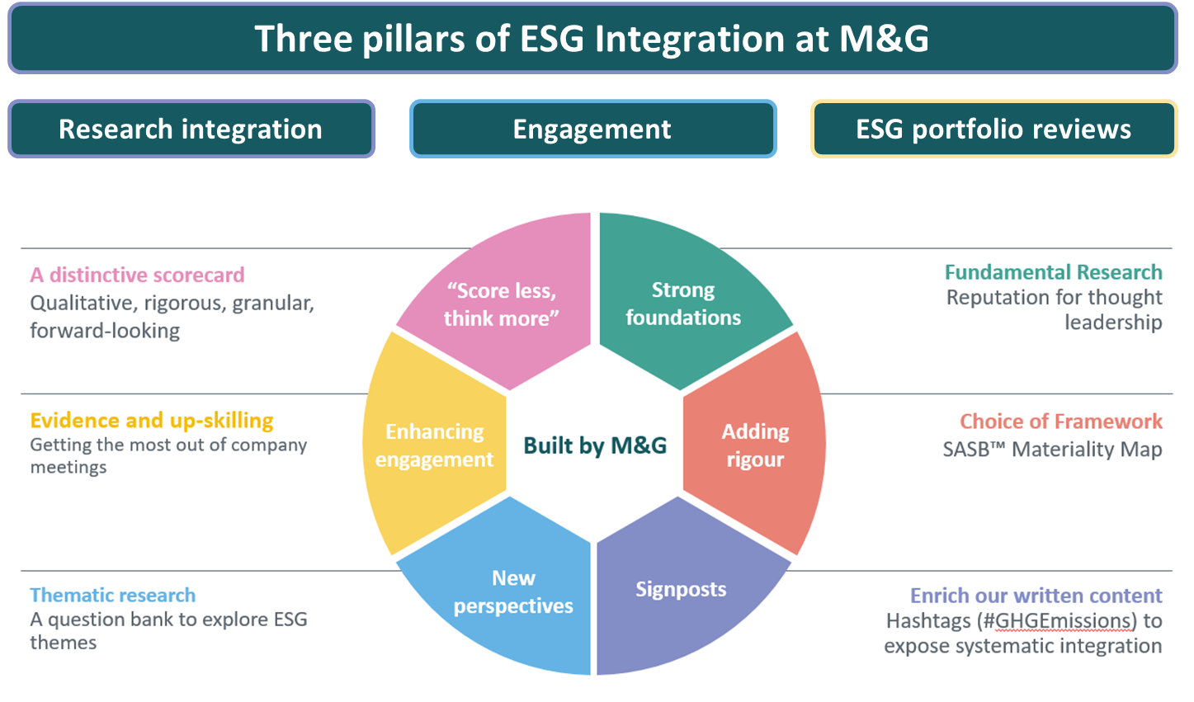
Delivering ESG Integration
ESG Integration is underpinned by three core pillars of activity
Source: M&G as at November 2020

Slide 24

M&G Climate Policy
Alignment with the Paris Agreement
“As a FTSE100 company and as a long-term asset owner and asset manager, M&G plc has a responsibility to our customers and to wider society to invest in ways which ensure a sustainable future, including tackling climate change and enabling a transition to a low carbon economy”
M&G public commitments:
Net zero in business operations by 2030
Net zero in Investments by 2050
Decarbonising existing portfolios & increasing investments in climate solutions
Source: https://global.mandg.com/~/media/Files/M/MandG-Plc/documents/responsible-investing/climate-change/MG-approach-to-climate-change_0420.pdf

Slide 25
Climate change approach
Portfolio mapping
Risk assessment
Engagement plan
Climate voting
Identifying M&G’s high carbon exposures
  Highest carbon emissions; largest M&G-wide exposure; access to management
Evaluating the risk represented by these exposures
  Assess transition risk and physical risk; evaluate company’s effective management of these risks
Structured plan for engaging with identified risk exposures
  Engagement programme focused on both bilateral and collaborative
Integration of climate change into M&G’s core voting policy
  Using shareholder resolutions and director elections as levers for accountability
The key focus is evaluating the risks to our portfolios

Slide 26
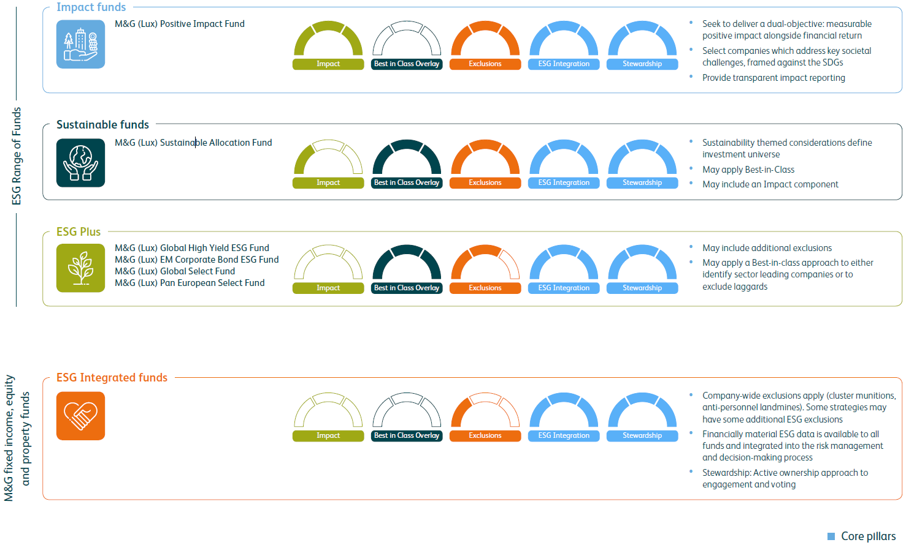
ESG product framework
As a minimum, all funds in the ESG range apply an agreed set of exclusions: companies involved in controversial weapons industry, UNGC violators, companies involved in tobacco (production, trading and distribution)*, adult entertainment (production and those deriving revenue from that business * and companies providing gambling services* * thresholds apply (5% max revenue from producers, 10% max revenue from distributors) ​
The value of investments, and the income from them, will fluctuate. This will cause the Fund price to fall as well as rise and you may not get back the original amount you invested.
Source: M&G, May 2020

Slide 27
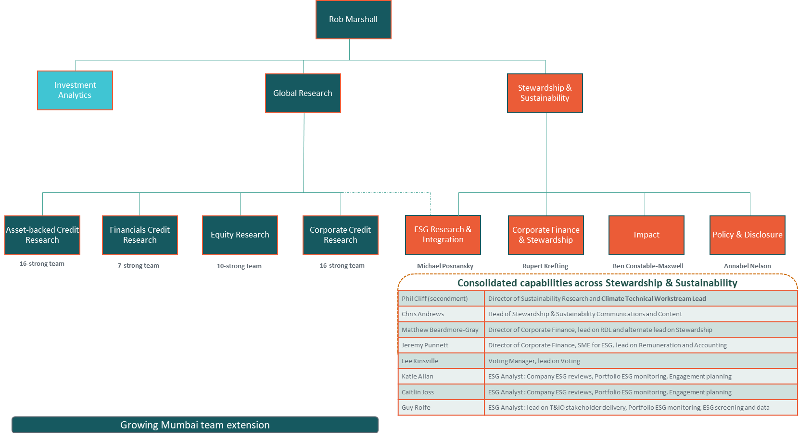
ESG support for investment teams
Research, Stewardship & Sustainability, Investment Analytics
Source: M&G, November 2020

Slide 28
For Investment Professionals only. Not for onward distribution. No other persons should rely on any information contained within.
This financial promotion is issued by M&G International Investments S.A. Registered Office: 16, boulevard Royal, L 2449, Luxembourg.

